Slide 1

Webpage Design

Slide 2

eLearning and
web content
Features Pricing Discussion Board
Cloud-based SaaS
Intuitive design interface
Multi-device publishing
Real-time multi-author collaboration and project management
Section 508 and SCORM compliant
Template-based development
Fast content creation
Flexible animation and interactivity
hiCreo: an eLearning and web content authoring and publishing tool.
Try hiCreo today and create your own content.
Start Free Trial
Notes:
hiCreo logo not easily visible
Navbar not easily visible
Call-to-action button (Try free now) should be bigger and more visible

Slide 3
Bubbles | Break out
X | Return on Investment (ROI)
X | Employee-generated Learning
X | All-in-one
X | Microlearning
X | Service Comparison
Intuitive design interface | ✓
Multi-device publishing | ✓ styled as, “Mobile Learning,” though
Section 508 and SCORM compliant | ✓ styled as, “Compliance,” though
Fast Content Creation | ✓
Cloud-based SaaS | X
eLearning and Web Content | X maybe the hiCreo overview could serve for this?
Real-time multi-author collaboration and project management | ✓ styled as, “Collaboration,” though (with no project management functions described)
Template-based development | X we discuss templates in “Fast Content Creation” section, as well as mention it in passing in other sections
Flexible animation and interactivity | X
One of the main issues is that the bubbles on the landing image/screen (slide 2) don’t match up with the subsequent “break out” feature/function explanations.
Not only do we need to match the terminology word-for-word, but I also think we need to make sure that whatever we put in a bubble, we have a “break out” explanation for, and vice versa.
I’ve marked the alignment & non-alignment areas in the table to the left.

Slide 4
HiCreo overview
How do we get to these sections? From the “Features” tab? Or continued scrolling?
What is hiCreo and why you should use it.
hiCreo is an eLearning and web content authoring and publishing tool using a cloud-based Software-as-a-Service (SaaS) subscription model.
hiCreo enables non-industry experts to build eLearning and web content themselves. With hiCreo, you don’t need an internal development team or large budget in order to share your knowledge. Our easy-to-use interface, thoughtfully designed library of templates, and interactive components mean that anyone can create beautiful and professional content.
Subscribe to hiCreo and convert your information into engaging eLearning and web content today.
Fully Cloud-based SaaS
ROI
.
.
.
Do we get to this section from “Pricing” tab? Or continued scrolling?
Pricing
Notes:
I think that the “What is hiCreo and why you should use it” and the “hiCreo overview” sections are basically the same thing. I don’t think we need both as separate sections

Slide 5



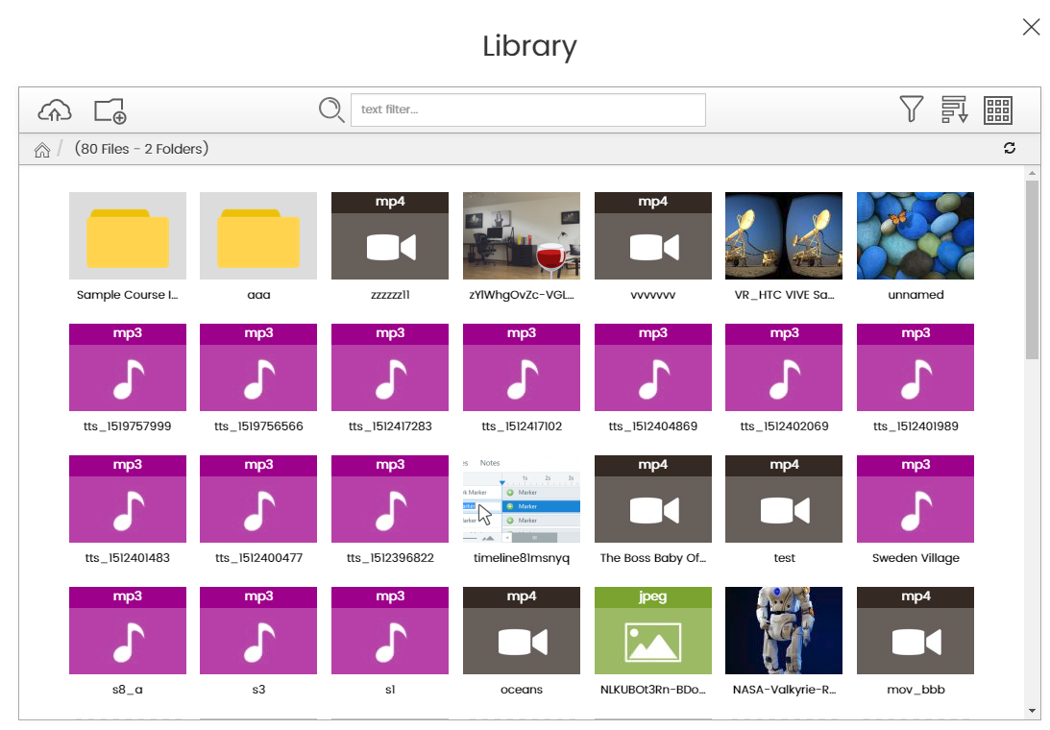
Return on Investment (ROI)
Fast Content Creation
In today’s ROI-centric business environment, eLearning must be cost-effective while still serving its purpose.
Not all eLearning content needs to be a custom-made work of art. Template-based content design significantly accelerates the development process.
You have the knowledge. We have the content design. With hiCreo, you can choose from an ever-expanding library of templates meticulously crafted by industry experts. Template-based content design significantly accelerates the development process. Rapidly create meaningful and engaging content.
(animation)
eLearning and web content are one of the best ways to train and develop people. Yet the cost is the significant amount of money, time, and experts needed for their initial creation.
hiCreo reduces cost by empowering businesses and individuals to build their own training and content. hiCreo itself acts as the computer programmer, graphic artist, instructional designer, and audio/video producer.
Without the cost of an internal development team, your return on investment (ROI) increases.
hiCreo reduces costs associated with eLearning development while producing greater results.
Use templates from a library of industry experts.
(animation)
Notes:
The ROI graphic doesn’t add much value; I think it needs to be specific to hiCreo and show how hiCreo cuts costs and results in a greater ROI. I thought we had an image that showed all the people that go into eLearning, and then the reduced amount of people that hiCreo needs?

Slide 6





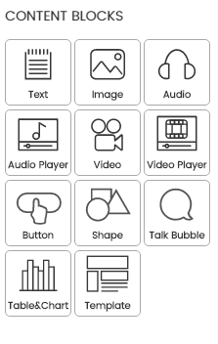
All-in-one
Intuitive Design Interface
Creating an eLearning content is a daunting, tedious process. Instructional designers and content developers are accustomed to working with labor-intensive tools to create eLearning content. As a result, costs are high and turnaround times are lengthy.
hiCreo is an all-in-one authoring system and publishing tool where you can import your content into templates and populate them, cropping images, amplifying audio, and enhancing videos.
hiCreo’s all-in-one authoring system allows a non-programmer to build the basics of a module, including interactive components such as quizzes, images, audio, and videos, within the storyboard.
hiCreo is created by Instructional designers and content developers for Instructional designers and content developers. Enough said!
hiCreo makes eLearning and web content authoring simple with its drag-and-drop, “What You See Is What You Get” (WYSIWYG) content development system. A WYSIWYG system allows users to edit in a form closely corresponding to its appearance when displayed as a finished product (e.g., eLearning course, web page, or document).
Whether you are an instructional designer, a subject matter expert (SME), or an experienced user, hiCreo’s user interface is easy and intuitive.
Authoring tool
Graphics tool
Video tool
Audio tool
Programming tool
Etc.
(drag and drop, content block build animation)
Notes:
The 3D graphic for the “All-in-one” section doesn’t match the look/aesthetic of the others.
The icon for the “Intuitive Design Interface” section looks gray rather than black – shouldn’t all the icons match?

Slide 7



Employee-generated Learning
Collaboration
Today, anyone can share knowledge efficiently and inexpensively. Any employee within an organization can now create eLearning courses about localized lessons in which he or she is an expert.
With hiCreo, any employee within an organization can now create eLearning and web content about localized lessons in which he or she is an expert.
With employee-generated eLearning and web content, you don’t have to go to the expense and logistical hassle of classroom training or the headache of buying off-the-shelf training that isn’t tailored to your workforce or its needs.
Use hiCreo to customize your content simply, quickly, and inexpensively.
hiCreo facilitates multiple stakeholders to collaborate and interact with each other in real-time while working on a project. Users of hiCreo can access and track progress of the course, communicate, give feedback, implement revisions, and seamlessly review progress.
hiCreo enables multi-author collaboration in real-time while working on a project. This allows more than one author to see the same content, and thus collaborate on it simultaneously. It also enables permission/role-based production workflows.
With multi-author collaboration, you can access and track content progress, communicate, give feedback, implement revisions, and seamlessly review.
Employee (expert)
Instructional Designer
+
Employee-generated Learning!
Subject Matter Expert
Content Developer
Reviewer

Slide 8




Mobile Learning
Microlearning
hiCreo creates once and publishes everywhere. Present your content on any device, whether a personal computer, mobile device, tablet, or television. The more portable your content, the more accessible it is to users who are increasingly working at their own pace, on their own schedules, at any and every location.
Share your content beyond traditional spaces.
hiCreo allows teaching and learning to extend to spaces beyond the traditional classroom.
Microlearning is the fastest, most effective way for today's employees to learn. Bite-sized, attention-grabbing topics are easy to access and apply right in the workflow.
Plus, microcontent is fast and affordable to create. That means your learning program will keep up with business priorities, no matter how fast things change.
Notes:
The icon for “Microlearning” is green; think it should be black to match the other icons.

Slide 9

Compliance
Section 508 Compliance refers to creating content that is accessible to all learners according to the standards set out in Section 508 of the Workforce Rehabilitation Act. Section 508 standards and templates are built into hiCreo.
Sharable Content Object Reference Model (SCORM) Compliance refers to creating content that is interoperable. Adherence to SCORM leverages interoperability, portability, reusability, sequencing, and durability. hiCreo’s course packages conform with a SCORM 1.2 module.
Section 508 Compliance refers to creating content that is accessible to all learners according to the standards set out in Section 508 of the Workforce Rehabilitation Act.
SCORM-compliant eLearning is necessary if you are delivering and tracking graded learning content via a Learning Management System, or LMS.
Notes:
The icon for “Compliance” is gray and blue; think it should be black to match the others.

Slide 10
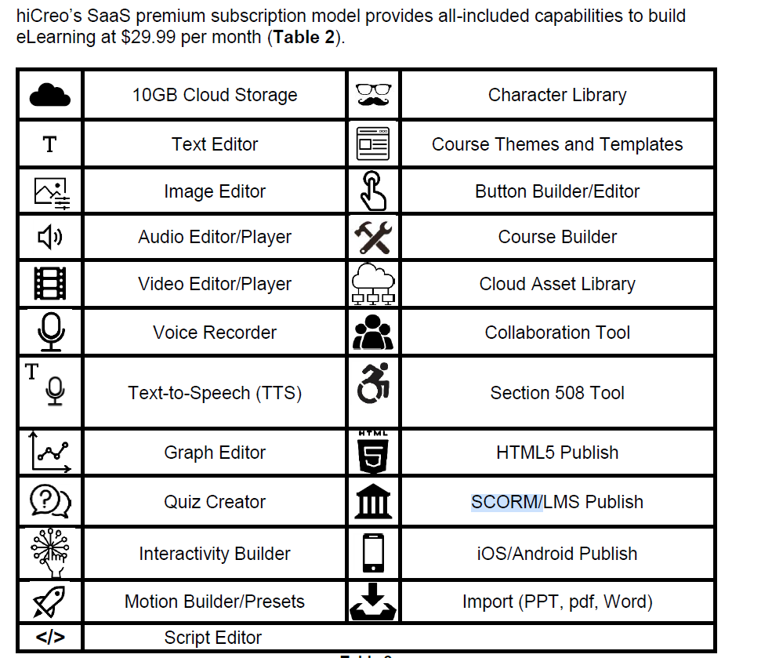
Service Comparison
hiCreo Key Features | Free | Premium
 |  | (Monthly) | (yearly)
Subscription Fee | $0 | $50 | $550
Text editor | ✓ | ✓
Image editor | ✓ | ✓
Screen capture | ✗ | ✓
Audio editor | ✓ | ✓
Voice recorder | ✓ | ✓
Text-to-speech | 1 voice | 5 voices & all future addons
Video editor | ✓ | ✓
Screen recording | ✗ | ✓
Table & chart editor | ✗ | ✓
Assessement editor | ✗ | ✓
Interactive object builder | ✗ | ✓
Course layout editor | ✓ | ✓
Course templates | ✓ | ✓
Page templates | ✓ | ✓
Content library | ✓ | ✓
Market house | ✓ | ✓
Section 508 | ✗ | ✓
SCORM/LMS publish | ✓ | ✓
iOS/Android publish | ✓ | ✓
Import (PowerPoint, pdf) | ✓ | ✓
Collaboration (voice, video, chat) | ✗ | ✓
Design Genie (AI) | ✗ | ✓
Storage | 100MB | 5GB
Do we offer a “free” version? Just for a trial, right?
Align the checkmarks within the column
What is the fourth column for? Where’s its heading? There are no checks.
The image below is what I had in my White Paper; obviously, it needs tweaking, but I like the idea of using icons to add visual interest to a big table.

Slide 11
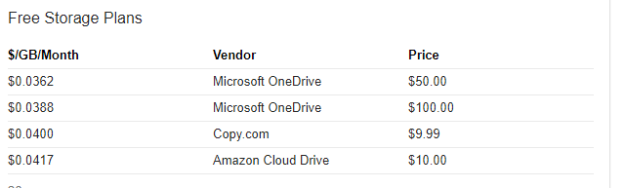
Notes:
Don’t understand the value of this slide?

Slide 12
So, what are you waiting for?
Give it a try!
Give hiCreo a try!
Would add a call-to-action button here, whether leading to a subscription/purchase portal or to a free trial log-in.

